Slide 1
Unit Testing and Test Driven Development (TDD)

Slide 2
What Is Unit Testing?
A test, at its simplest, is something that "runs the code under test".
When software developers write source code, someone needs to validate that this code performs as expected.
In order to do so, a team of software testers usually runs the source code in question.

Slide 3
What Is Unit Testing?
When running code "under test", a tester runs a selection of source code in order to ascertain whether or not the actual result of running that selection was the expected result.
The expected result is determined by the software requirements specifications and the test data used for the test.
If the actual result of a test differs from the expected result, that test is a failed test.
The result of a failed test is known as a defect.
Once a software tester finds a defect, a software developer might attempt to modify the source code in a way that causes the source code to produce the expected result when supplied with the same test data that led the test to fail.

Slide 4
What Is Unit Testing?
This process of running source code under test is often conducted both manually and via an automation framework.
One software tester might manually input test data while running the application and report the results of doing so using a reporting tool.
Yet another tester, however, might write unit tests in their language of choice and package those tests with the source code so that the development team can easily run test scripts once the source code is delivered to a central repository.

Slide 5
What Is Unit Testing?
Unit testing, on the other hand, is about more than running source code against tests.
Unit tests prioritize testing source code in isolation.
This process entails testing the "smallest" unit of code possible. This unit is often, for instance, a single method.
If a unit should depend on another unit, testers typically use mocks or stubs in order to isolate the unit from its dependency during the test.

Slide 6
Benefits of Unit Testing
Encourages Writing Testable Code
Isolate Defects In Source Code
Cost-Effective
Improves Overall Code Quality
Confidence When Refactoring

Slide 7
Test-Driven Development (TDD)
Test-driven development (TDD) is an approach to software development in which each line of code is "written in response to a test that a programmer writes just before coding".
In other words, test-driven development emphasizes a "test-first" approach in which programmers create test cases first and then write source code which passes these tests.
When using a test-driven approach to software development, programming, testing, and refactoring code are closely intertwined.
A developer who subscribes to test-driven development typically writes the appropriate test cases, writes the source code, runs the tests, and then refactors the code as necessary.

Slide 8
Benefits of Test-Driven Development
Introduction of Fewer Defects Into Source Code
Improved Software Design

Slide 9
The Hazards of Test-Driven Development
Writing a Large Number of Tests At Once
Creating Extremely Trivial Tests
Creating Tests That Are Too Broad

Slide 10
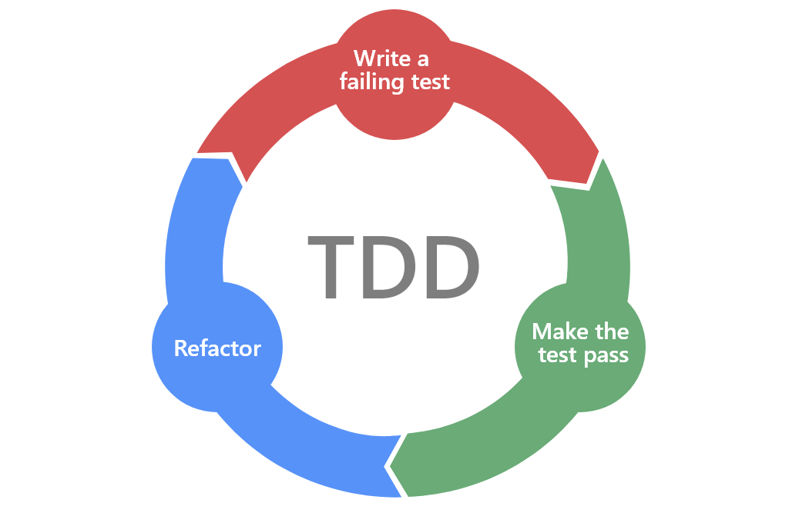
Test-Driven Development (TDD)

Slide 11
Implementing Test-Driven Development
Write a unit test (or several unit tests) which details a feature of the application you're writing.
The source code for this feature of the application should not exist before writing the test.
Run the test you have just written.
Needless to say, the test will fail as you have not yet written the source code for the feature.
Write the source code which will make the test pass.
Don't make the source code overly complex; it should do just enough to pass the the test.
If the test fails, refactor the source code. Again, don't make the source code complex.
Just refactor the code until it passes the test.
Even if the test passes, you might also refactor the code to make it simpler and more concise.
Repeat this process for all other features you implement.

Slide 12
What Is JUnit?
JUnit is a popular, open-source testing framework for Java.

